Slide 1
Flood Hazard Mitigation Task Force #5
Meeting Date: March 25, 2025
Regional Drainage Improvement Program
City of Bellaire

Slide 2
Agenda
Introductions and Project Background
Next Steps and Decision Points
Public Comment – Public comments limited to three (3) minutes per speaker
Adjourn
Review of Progress to Date
WO #1 Recap
WO #2 Recap
Preliminary Engineering for Ditch Improvements, Detention Basins

Slide 3
Scope of Work (Ardurra) – High Level
Launch our flood risk reduction program efforts
Quickly refine objectives, design criteria, and flood damage prevention ordinances
Validate and review recommendations from the MDCP, allowing our new consultant to take ownership of the program moving forward
Advance high priority “first phase” improvements, establish long-term implementation strategy
Develop funding roadmap
Support pursuit of partner funding and submittal of grant applications

Slide 4
Work Order # 1 Recap
Developed refinements to Flood Damage Prevention Ordinance/Development Codes
  Direct result of public feedback from FHMTF, other citizen boards
Developed drainage criteria for future improvement projects
  Incorporated feedback from the FHMTF
Validated the MDCP recommendations and prepared concept level improvements for Cypress Ditch and IH-610 storm sewers, identified opportunities for regional detention
Developed a roadmap for funding recommended projects and submitted applications for funding under CDBG, FMA
Identified and coordinated with potential project partners
Initiated First Phase projects

Slide 5
Work Order #2 Recap
Completed preliminary engineering for First Phase projects
  Cypress Ditch improvements
  Regional detention
Coordinated with TxDOT to advance the IH-610 storm sewer improvements
Identified, designated specific routes for emergency access
Updated funding roadmap to account for new funding opportunities and reflect further project refinement
Continued to pursue partner funding opportunities and submit grant applications

Slide 6
First Phase Projects
Cypress Ditch expansion and improvements
Includes widening, lowering of the HCFCD channel
IH-610 storm sewer improvements
Analyzed multiple configurations to evaluate costs and benefits
Meeting with TxDOT to advance improvements
Surface detention for proposed improvements
Volume required to support Cypress Ditch improvements and facilitate future improvements

Slide 7
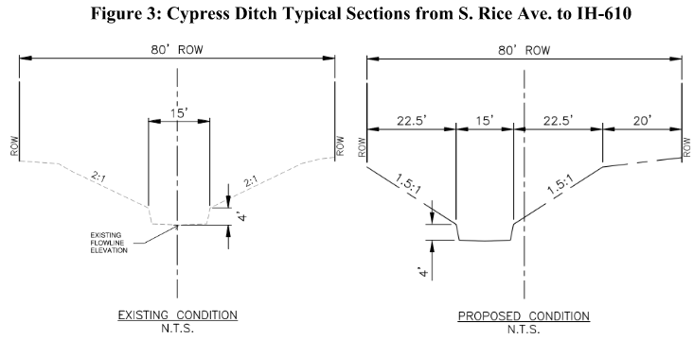
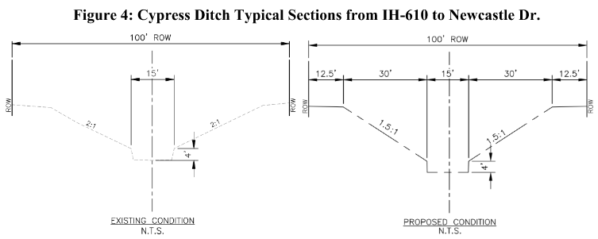
Cypress Ditch Improvements
Forms the foundation of future infrastructure improvements
Optimize channel capacity by maximizing width and depth within existing right of way
Coordinate with potential improvements to IH-610, other City systems, and regional detention

Slide 8
Detention Basins
Provide volume to mitigate the improvements to Cypress Ditch
Maximize available volume across the selected sites
Potential future opportunities to incorporate, integrate recreational amenities

Slide 9
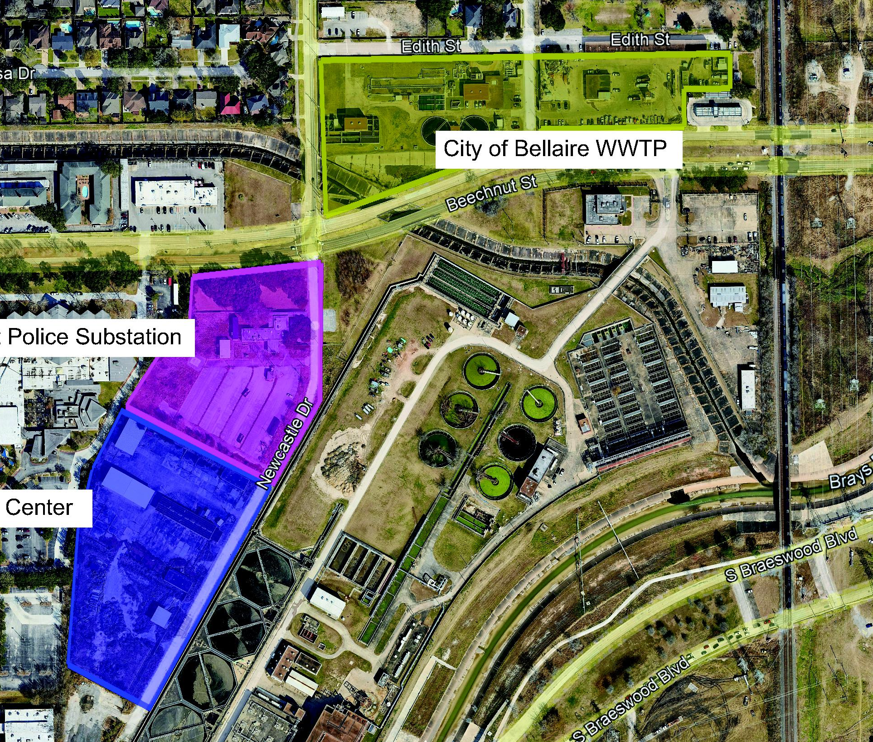

Slide 10
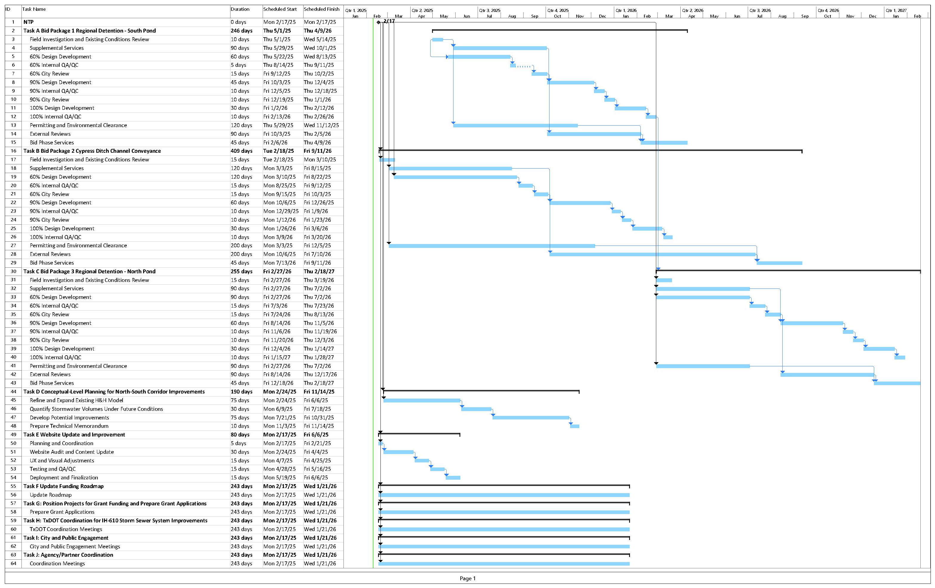
Notes:
Need new schedule

Slide 11
Grants and External Funding Pursuits
FUNDING SOURCE | APPLICATION DATE | PROJECT(S) SUBMITTED FOR FUNDING | Status
CDBG-MIT | June 7, 2023 | Cypress Ditch Central Portion submitted in 2023 | Not awarded
DOT Reconnecting Communities and Neighborhoods (RCN) | September 28, 2023 | Cypress Slough Trail | Not awarded
TWDB Flood Mitigation Assistance (FMA) | January 8, 2024 | North Bellaire Flood Risk Mitigation and Resiliency Study | Moved to next level of review
HGAC Transportation Improvement Program (TIP) | February 13, 2024 | Chimney Rock Corridor S Rice Corridor Newcastle Corridor | Not awarded
TWDB Flood Infrastructure Fund (FIF) | April 15, 2024 | Chimney Rock Area Drainage Improvements Study Newcastle/Kilmarnock Drainage Improvements Study Local Drainage Asset Management Study | Chimney Rock and Newcastle/Kilmarnock ranked 73 in the Prioritization List
Community Project Funding (CPF) | May 3, 2024 | Cypress Ditch | Awarded in 2024 but rescinded in 2025. Will resubmit if available
HGAC Water/Wastewater Utility and Flood Mitigation Priority Project Lists | August 14, 2024 | Cypress Ditch Regional Detention Wastewater Transfer Project | Cypress Ditch identified as a Tier 1 (Top Priority) Regional Priority Project, others as Tier 2
FUNDING SOURCE | APPLICATION DATE | PROJECT FOR FUNDING
CDBG-MIT - submitted | June 7, 2024 | Cypress Ditch Central Portion submitted in 2023
DOT Reconnecting Communities and Neighborhoods (RCN) – submitted, not successful | September 28, 2023 | Cypress Slough Trail
GLO Resilient Communities Program - submitted | Open to June 2028 | Home Elevation Program
TWDB Flood Mitigation Assistance (FMA) - submitted | January 8, 2024 | North Bellaire Flood Risk Mitigation and Resiliency Study
HGAC Transportation Improvement Program (TIP) - submitted | February 13, 2024 | Chimney Rock Corridor S Rice Corridor (includes Terminal St, Leigh St, Saxon St, Glenmont Dr) Newcastle Corridor
TWDB Flood Infrastructure Fund (FIF) – applications in progress | Due April 15, 2024 | Chimney Rock Area Drainage Improvements Study Newcastle/Kilmarnock Drainage Improvements Study Local Drainage Asset Management Study

Slide 12
Next Steps
Begin final design of Cypress Ditch, Detention Basins
Develop preliminary design documents
Track existing grant application, position for additional grant funding
Develop potential partnerships
Council decision on wastewater treatment plant plan
Options considered: construct new WWTP, demolish existing WWTP and transfer wastewater to COH SW WWTP across Beechnut
Kick off remaining tasks
Website updates and improvements
North/South Corridor Drainage Study
(pending grant funding)
Coordinate with TxDOT
Continue to strategize program funding
Continue to pursue state and federal funding opportunities
Continue to seek partnerships

Slide 13
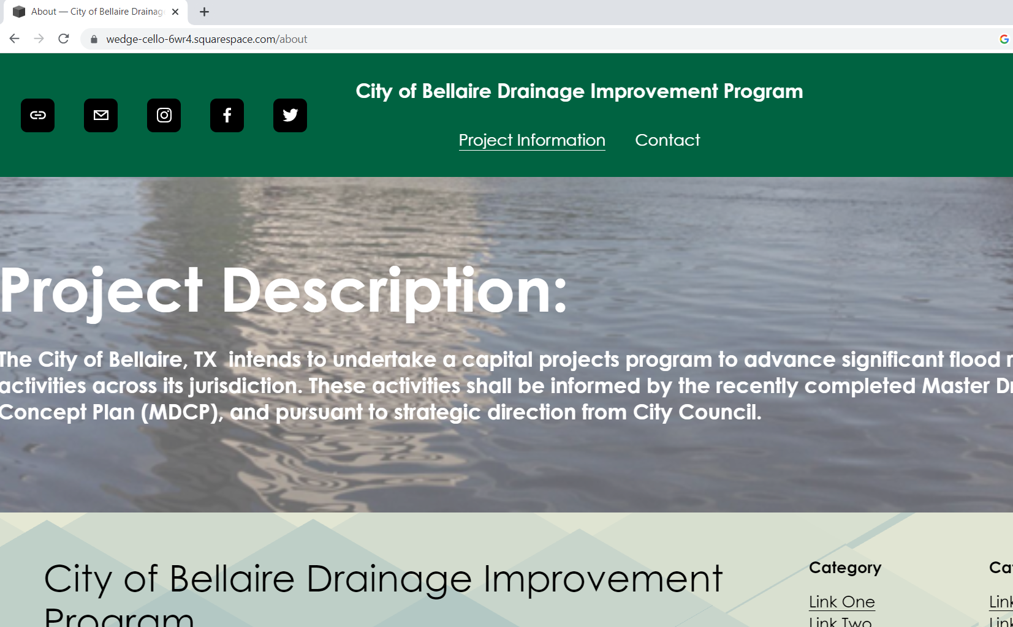
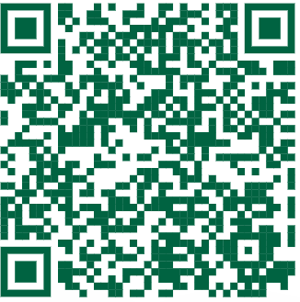
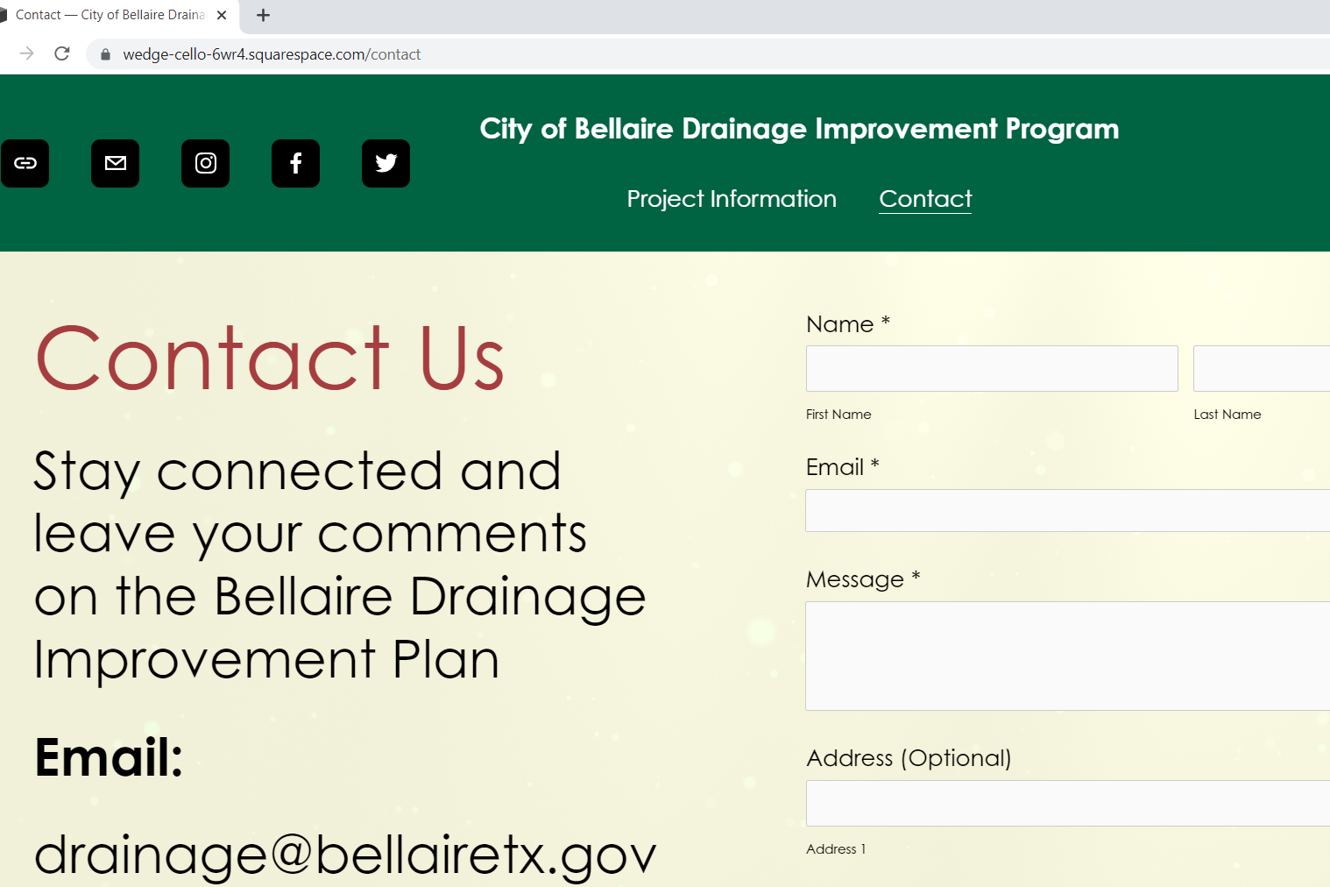
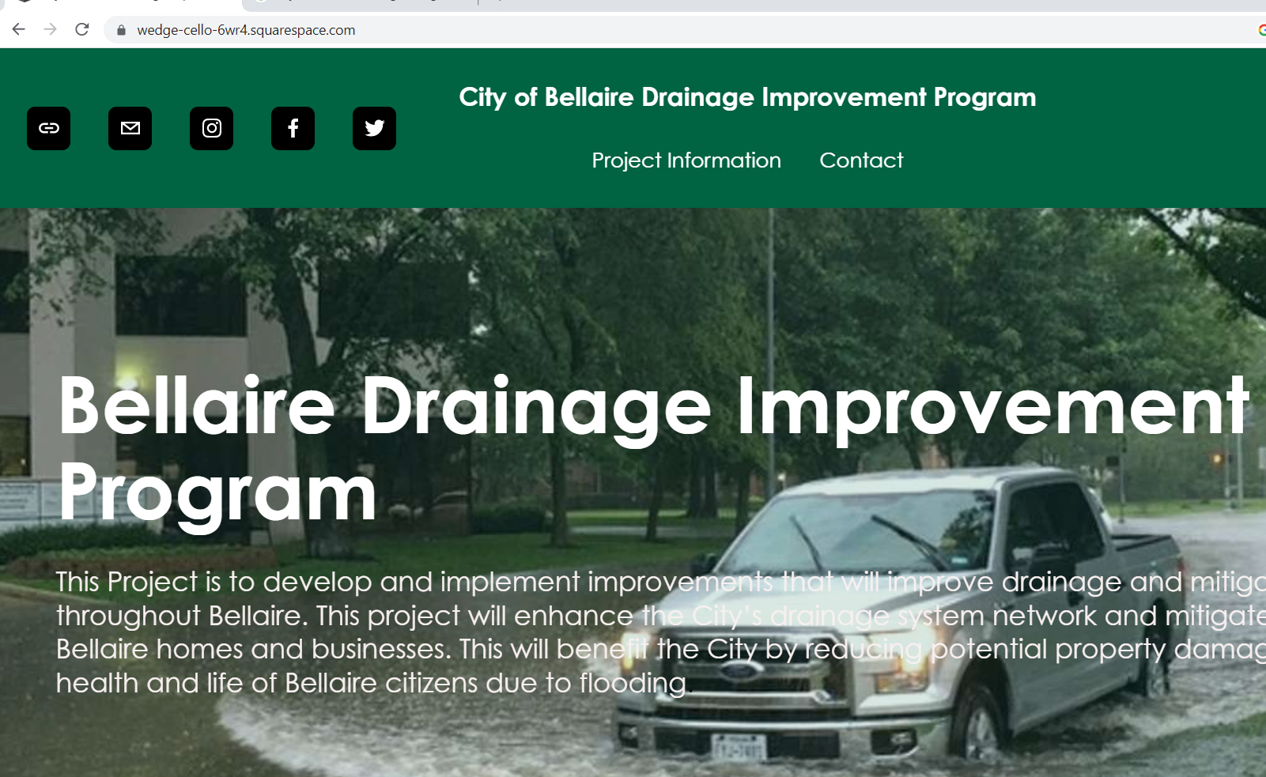
Questions?
Check the program website at https://bellairedrainageimprovementprogram.org/
Or email us at drainage@bellairetx.gov

Slide 14

Public Comment
Limit to three (3) minutes per speaker

